Slide 1
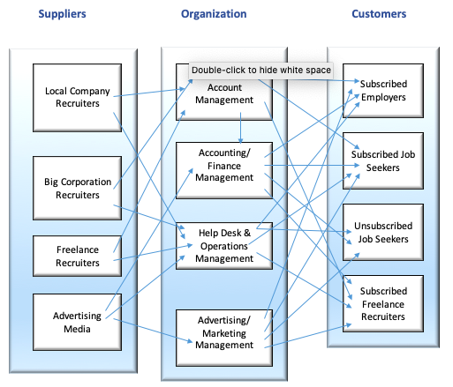
Jobster Business Relationship Map

Slide 2
